Slide 1


Data Analysis (British Airways Reviews)
By, Rahul Kumar

Slide 2
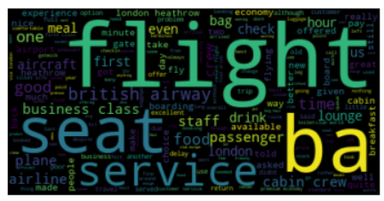
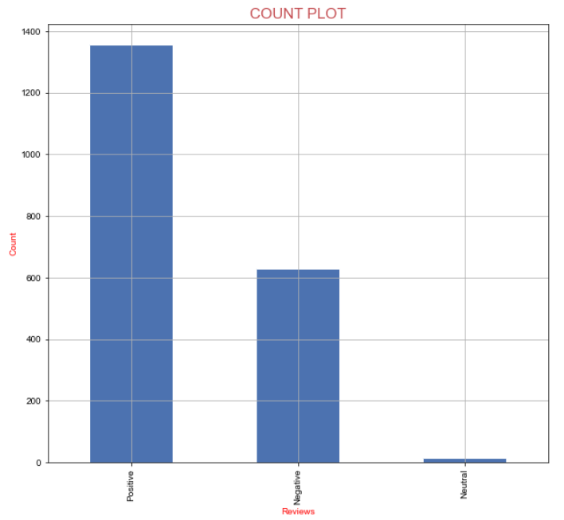
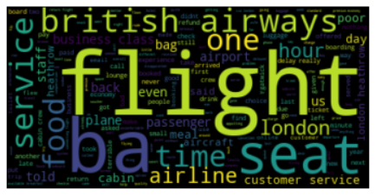
Key topics for Positive review
(Flight, seat, service, ba, food, passenger, lounge, business class, staff, drink, meal and lounge)
Key topics for Negative review
(Flight, British airways, service, food, ba, seat, time, airline, customer service, London, customer service and one)
The extracted dataset contains (out of 2000 Reviews):
1355 (67.75%) positive reviews,
629 (31.45%) negative reviews and
16 (0.8%) neutral reviews

